Slide 1
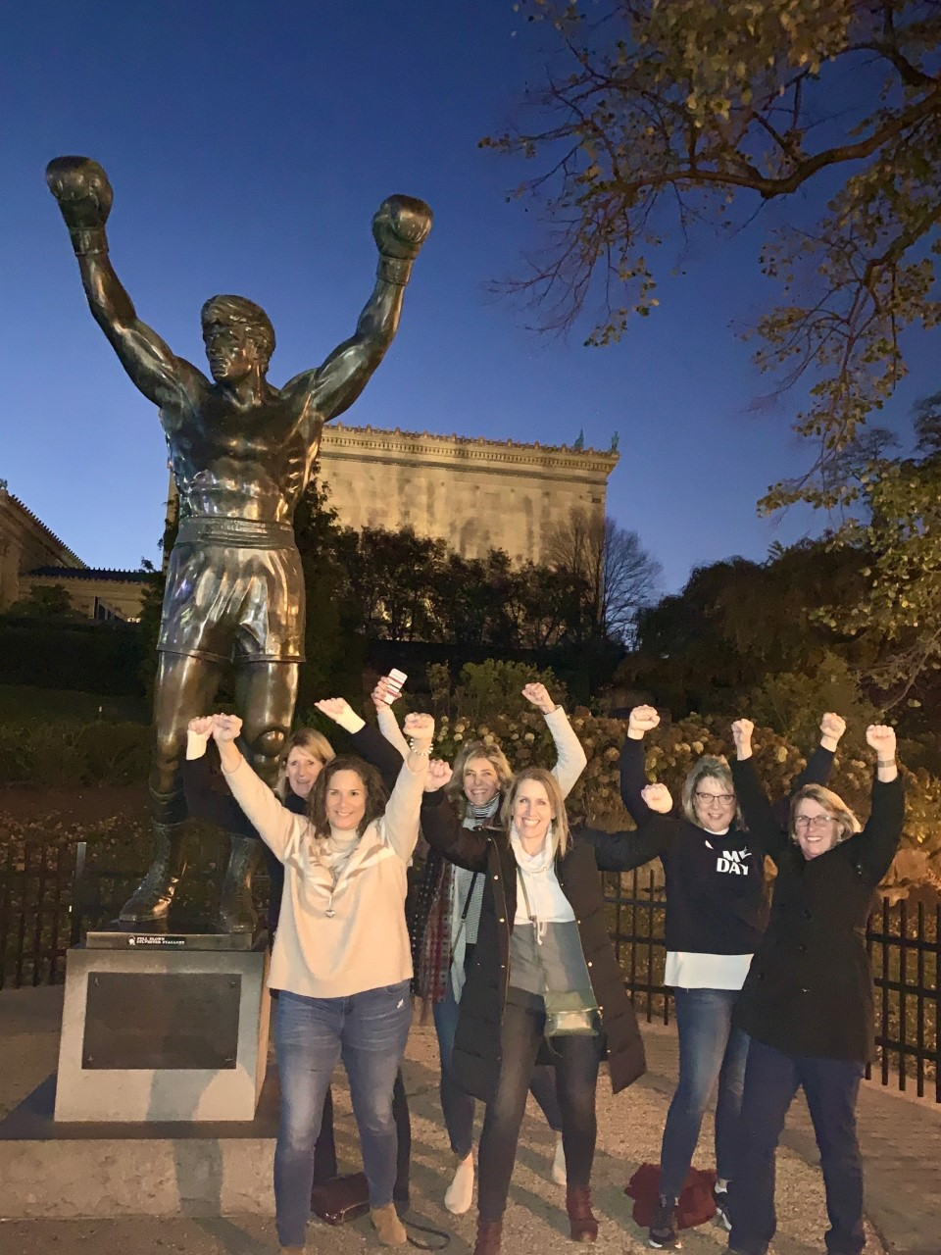

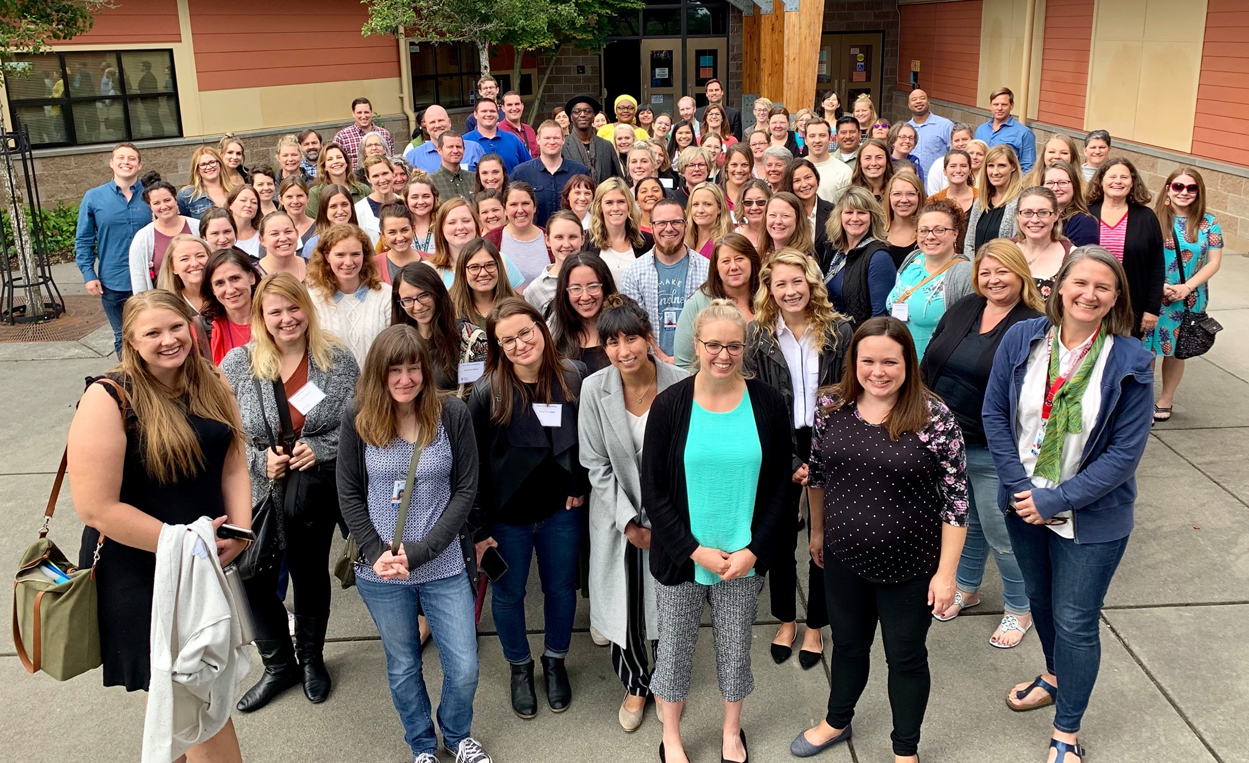

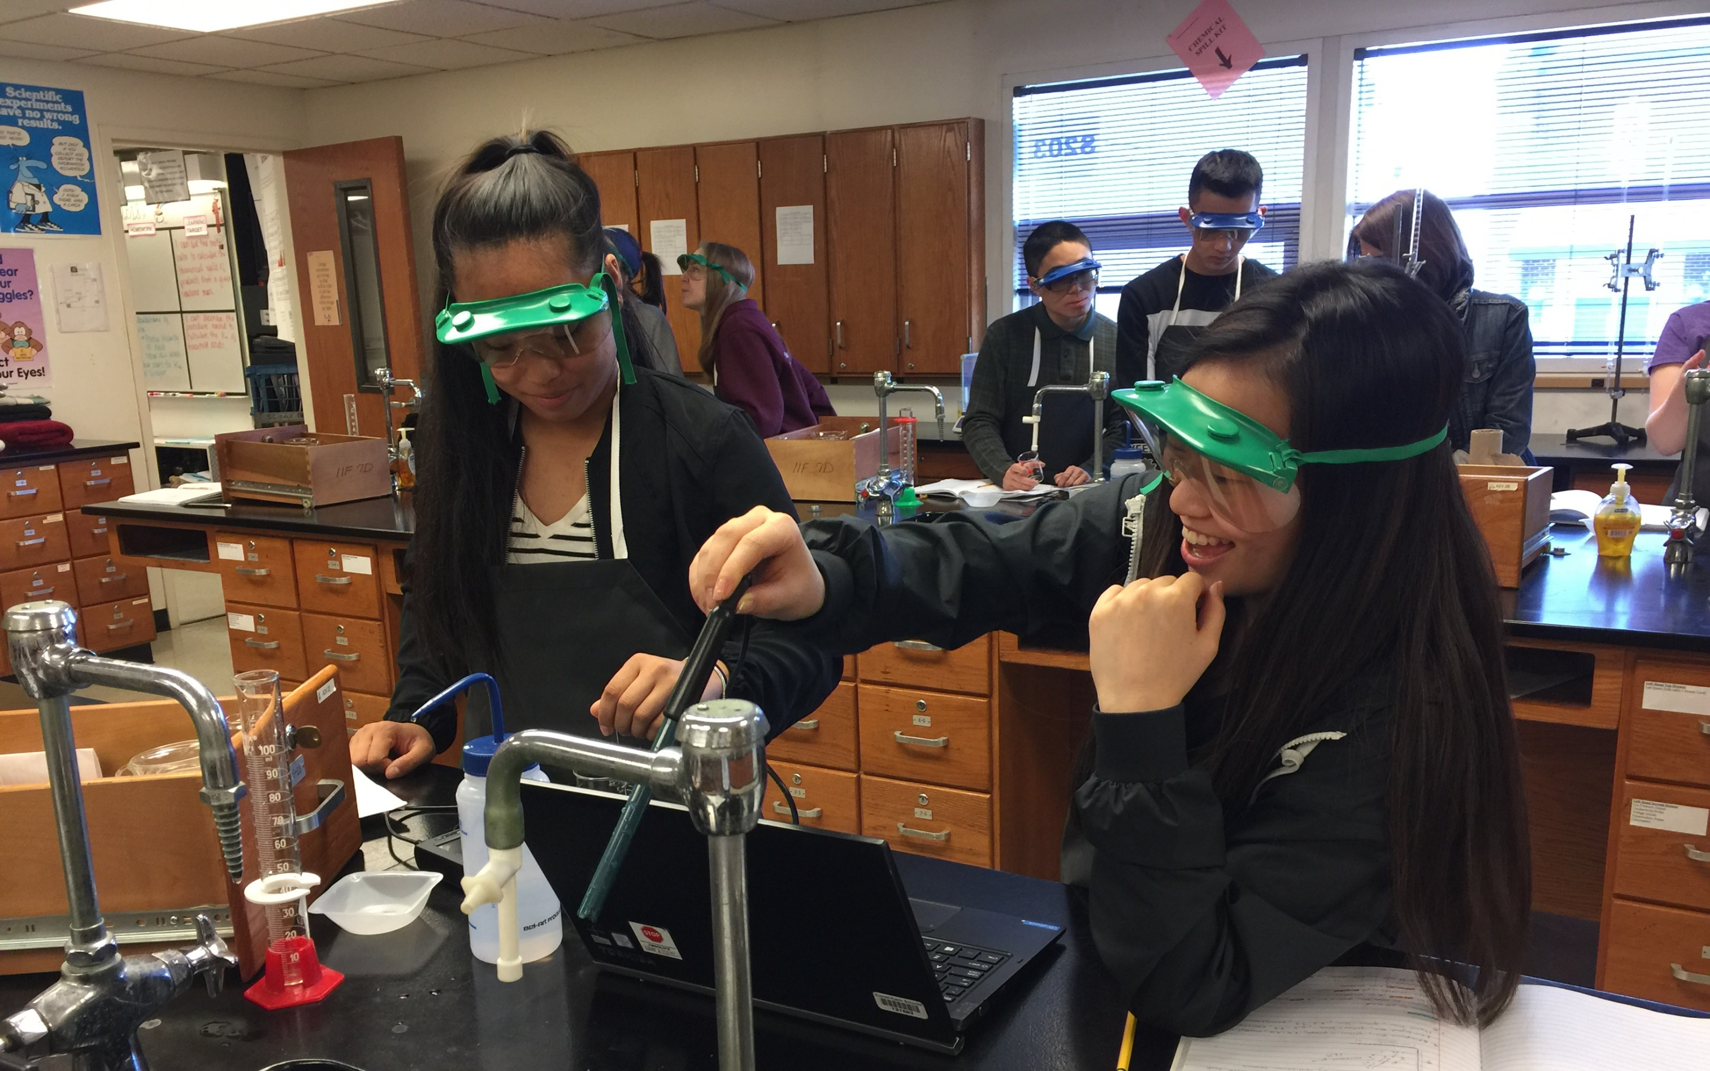
Human Capital
Understanding the “why” of the work
January 13, 2020 Regional Meeting
Notes:
Add photo

Slide 2
Outcomes
Understand the principal’s role as human capital leaders
Understand shift in human resources support
Understand the accelerated hiring timelines and impacts

Slide 3
Strategic Human Capital Management
The collective and individual knowledge, skills and abilities available to apply to an organization’s goals*
USHCA’s 4 Principles of Strategic K-12 HC Work
Contributes to the quality of teachers and principals
Aligns to instructional improvement needs
Provides schools/principals more autonomy and builds their capacity as HC managers
Measures key indicators for continuous improvement
* Definition adapted from Teaching Talent: A Visionary Framework for Human Capital in Education
Notes:
So what is HC?
At the elementary levels meeting, Heather and Brenda provided an introduction to strategic human capital management. And secondary received a very brief overview as well. And, this will be the work of HR in support of principals as human capital leaders now and in the future
To do this well – we need to be purposeful about our HC strategy and manage it more strategically by using the 4 principles outlined here.
Essentially, these four principles will guide our work as we develop the program and focus on the most immediate work ahead us, which is hiring the most qualified teachers in an accelerated process.
The purpose for us today is to explain why we are having this job fair in March and clarify each of our responsibilities in this process.
After our presentation, regionals will facilitate a new way of interviewing by working with you to develop development of the interview questions to be used at the job fair.

Slide 4
What is the Principal as HC Manager?
Principals are the key customer of an HR/HC team
Principal as HC Manager refers to a principal’s key role in actively managing the talent in their schools in service of student learning
HR/HC must shift from command & control to service & support
Notes:
The hiring process is shifting to the: (review bullets)
Bullet #1: HR has gather feedback over the last year. In the next two months you will see the changes responsive to the feedback provided from each of you keeping you from the “right” work: (highlight at this presentation indicating details later)
Transfer process -
Screening candidates
Number of candidates
Response rate for approval to hire
Other?
Bullet #2: Now the principal’s key role is (READ BULLET).
What does this look like now?
The pool process has been eliminated, screening and application process has changed (more detail will be provided at the February meetings)
In addition to the information that will be shared at February meetings, principals will receive an invitation from HR for 1:1 tutorials on the process before the start of the transfer period
Bullet #3: What we explained here is the background pieces HR has put in place to assist you in hiring the best candidate for your individual buildings

Slide 5
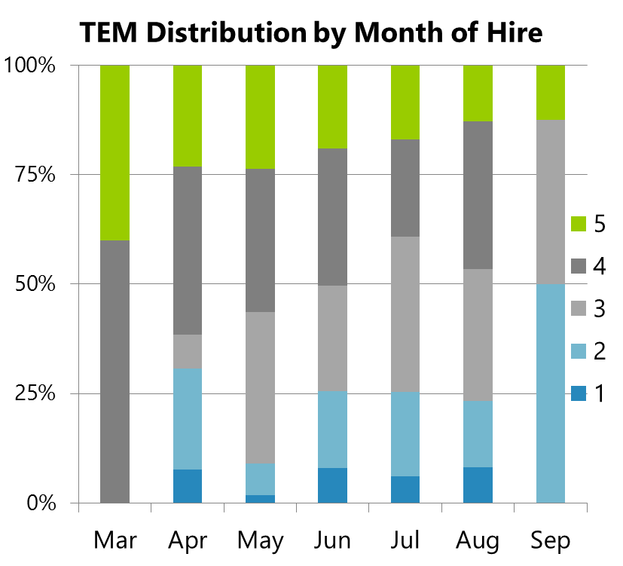
What the Research Tells Us
Early hiring is the single most important factor related to new hire quality.
60% of teachers hired in March-May received effective and highly effective ratings. Just 40% of those hired in June-August were as effective.
Level of Effectiveness by Month of Hire
n=5 n=13 n=55 n=137 n=130 n=86 n=8
Notes:
Slide#7 from SPS PPT
The earlier they are hired, the more effective and capabile the candidates are which impacts student learning.

Slide 6

EPS Certificated Job Fair
Notes:
Place postcard artwork here (see Randi’s email)
All of this is in preparation for the job fair!

Slide 7
Certificated Hiring Timeline
January 13 – Initial development of interview questions
January 29 – staffing allocation meetings
January - March
  generic certificated positions posted
  generic applicant screening
  Invitations to selected candidates
February – interview questions finalized
February 7 – staffing workbooks due to Financial Service (no exceptions)
February 25 – March 15 – school specific vacancies posted for internal transfer only in preparation for job fair
Revert to external and internal job postings following job fair
Notes:
1/13 –In addition to the work we are doing today, this is already occurring behind the scenes in HR
LOA –notification of intent to return due to HR
Unassigned – notification due HR
Incentive for early retirement/resignation – deadline 1/24 with no exceptions on this deadline
No additional leave replacement conversions – please notify Randi if you want LR candidates invited to the job fair
1/29 staffing allocations distributed at A & S meeting
Bullet #3 - READ FROM slide
Bullet #4 - Internal transfer process window:
Principals MUST have expedient conversations each week with internal candidates in order to identify actual openings for the job fair
EEA is working with us on this
These jobs will NOT be posted externally as they will be open for interviews at the job fair
How are external candidates going to know about my openings? That’s the purpose of the generic postings and the advanced screening of candidates.
A list vacancies by building will be provided to candidates at the job fair
Last bullet – READ bullet and add…through July 10

Slide 8
Week of Certificated Job Fair
March 16 – 20 – no postings
March 18 – schools notified of open positions
March 20 – principal and team at job fair
Notes:
If no vacancies in your building – you will be assigned to support the process
We will address classified hiring separately

Slide 9
Questions
Notes:
Clearly this is a huge shift in practice and we will be working with you over the next few weeks as we plan for this event.
It is critical that you stay apprised of communication from HR through the various mediums.

